Slide 1
Predicting Temporal Sets with Deep Neural Networks
Source: KDD '20
Speaker: Po-Jen, Wen
Advisor: Jia-Ling, Koh
Date: 2021/5/17

Slide 2
OUTLINE
Introduction
Method
Experiment
Conclusion

Slide 3
Introduction

Slide 4
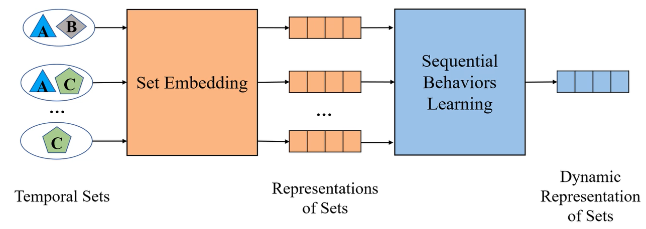
Introduction
Existing methods usually follow a two-stage strategy(DREAM):
(1)Set embedding
(2)Sequential behaviors learning
INFORMATION LOSS！！！

Slide 5
Introduction

Slide 6
Introduction
Let $U=\{u_{1},u_{2},…,u_{n}\}$, $V=\{v_{1},v_{2},…,v_{n}\}$ denote the set of $n$ users and $m$ elements, a set $S⊂V$ denotes the collection of elements.
Given:
A sequence of sets $S_{i}=\{S_{i}^{1},S_{i}^{2},…,S_{i}^{T}\}$ that records the historical behaviors of user $u_{i}∈U$
Goal:
Predict the next-period set of $u_{i}$, ${\hat{S}}_{i}^{T+1}=f\left(S_{i}^{1},S_{i}^{2},…,S_{i}^{T},W\right),$ where $W$ is the trainable parameter

Slide 7
Method - Deep Neural Network for Temporal Sets Prediction (DNNTP)
Fuse static and dynamic information
by a gated updating mechanism
Learn temporal dependencies of
elements in the sequence of sets
Learn set-level element relationship

Slide 8
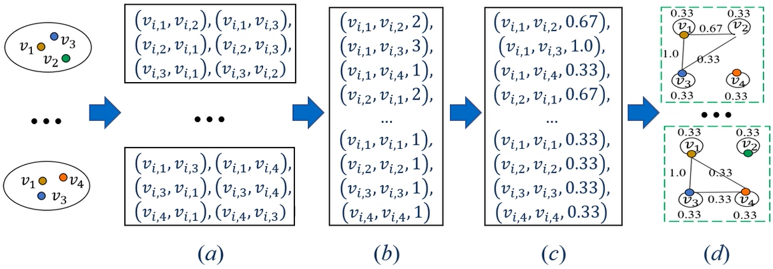
Element Relationship Learning
Learn element relationship in the same set.
(1)Weighted Graphs Construction
appearing frequency
(2)Weighted Convolutions on Dynamic Graphs
Trainable convolutional parameter

Slide 9
Attention-based Temporal Dependency Learning
Learn element temporal dependency among the sequence of sets.
Masked matrix
A trainable parameter to learn the importance of different timestamps

Slide 10
Gated Information Fusing
Mine shared patterns and fuse static and dynamic representations of elements.
An indicator vector
Controls the importance of static and dynamic representations

Slide 11
The Learning Process
Prediction:
Loss function:

Slide 12
Experiment
Datasets
Compare methods:
TOP, Personal TOP, Element Transfer, DREAM, Sets2Sets
Three evaluation metrics:
Recall, NDCG, PHR

Slide 13
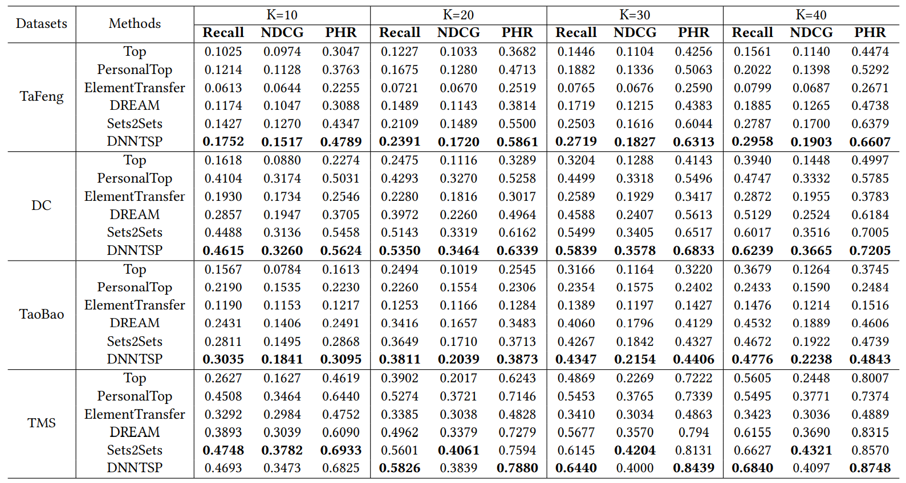
Experiment

Slide 14
Experiment
Model is applicable to scenarios with sparse data

Slide 15
Conclusion
An element relationship learning module to capture multiple set-level element relationships
An attention-based temporal dependency learning module to learn the temporal dependencies of the sets and elements from the whole sequence
A gated information fusing module to discover the shared patterns among different sequences and fuse both the static and dynamic information.
Experimental results demonstrate that method could circumvent the information loss problem suffered by the set-embedding based methods, and achieve higher prediction performance than the state-of-the-art methods.

